Slide 1
Unified Carrier Registration
Plan (UCR) Enforcement
Notes:
Welcome, everyone. Today we’re going to walk through the UCR Enforcement Training. This session is designed to provide a comprehensive overview of the enforcement process, key responsibilities, and the tools and resources available to support our efforts. Let’s get started.

Slide 2
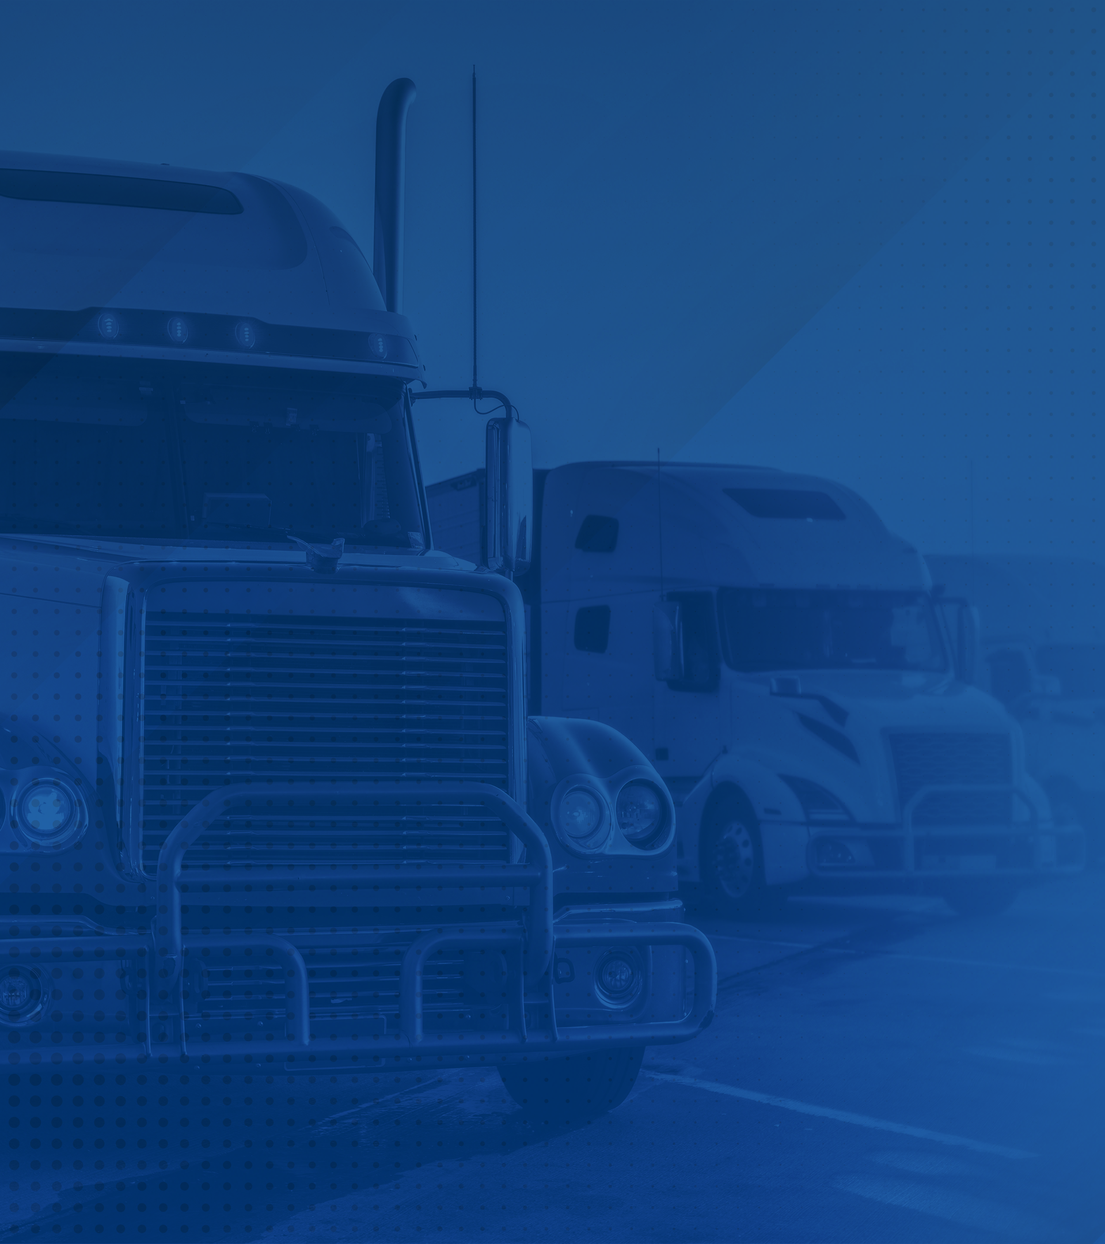
Introduction
Purpose
Value
Applicability
How to Verify
How to Enforce
UCR Statistics
Scenarios
Helpful Tools
Summary
Notes:
By the end of this training, you’ll be able to explain the purpose of UCR enforcement, identify the entities involved, describe the roadside enforcement process, and access relevant tools and resources. These objectives will guide us through the core content today.

Slide 3
Purpose
Purpose of the Unified Carrier Registration Plan (UCR)
Notes:
First, we’ll discuss the historical context and purpose of the Unified Carrier Registration Plan.

Slide 4
Purpose of UCR
The UCR Plan was enacted by congress to replace state revenue lost after the dissolution of single state registration system administered by the Interstate Commerce Commission. UCR funds shall be used for motor carrier safety programs, enforcement, or the administration of the UCR plan and UCR agreement.
Notes:
The Unified Carrier Registration Act (UCR) was established by federal law in the UCR Act, which is part of the federal highway reauthorization bill known as the Safe, Accountable, Flexible, Efficient Transportation Equity Act, A Legacy for Users (“SAFETEA-LU”), Public Law 109-59, enacted August 10, 2005.
Previously the Interstate Commerce Commission (ICC) existed and registered motor carriers and collected registration fees. After the ICC was abolished by Congress, the Federal Motor Carrier Safety Administration was eventually created and assumed the duties of registering motor carriers. However, collection of interstate operating fees was assigned to the Unified Carrier Registration.
The UCR Agreement may be found in 49 United States Code (USC) Section 14504a.
At its core, the UCR Plan ensures that states continue receiving funding for motor carrier safety and enforcement programs. This funding supports personnel, technology, and other tools critical to highway safety.
The program’s success depends on achieving high registration rates—ideally 85% or higher. Enforcement plays a key role in reaching that goal by identifying unregistered carriers and issuing appropriate citations or civil fines.
There are also consequences for under-enforcement. States may face audit findings, miss out on potential revenue from fines, or lose credibility in future fee allocation discussions.
Ultimately, UCR is not just about collecting fees - it’s about maintaining a safe, fair, and well-funded commercial transportation system.

Slide 5
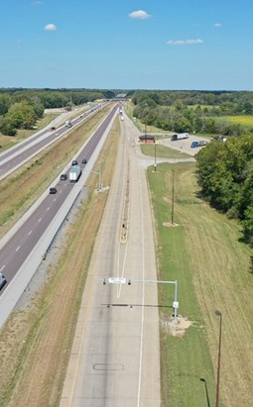
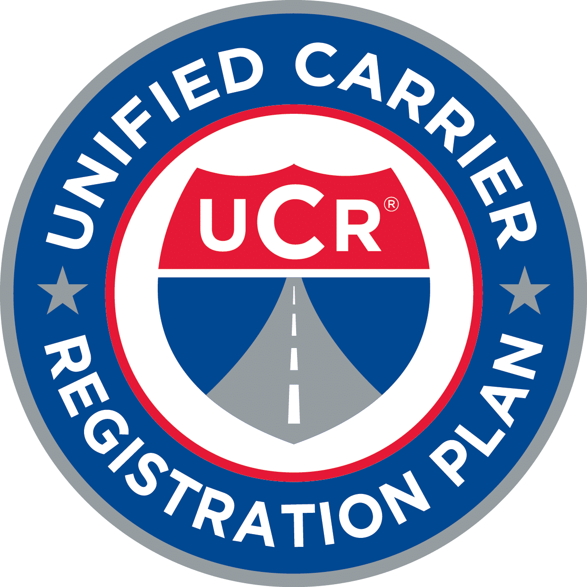
Definitions
Interstate commerce means trade, traffic, or transportation in the United States —
Between a place in a State and a place outside of such State (including a place outside of the United States);
Between two places in a State through another State or a place outside of the United States; or
Between two places in a State as part of trade, traffic, or transportation originating or terminating outside the State or the United States.
Intrastate Commerce – Transportation of property or passengers that originate and are destined solely inside of a state.
Notes:
When it comes to UCR enforcement, understanding the difference between interstate and intrastate commerce is critical.
Interstate commerce refers to trade, traffic, or transportation that crosses state lines or national borders. The key factor is the intent of the shipper at the time the shipment is arranged. If the shipper intends for the goods to ultimately cross state or national boundaries, it’s considered interstate, even if the vehicle itself stays in one state. In some cases, the vehicle’s movement can also determine the classification.
Intrastate commerce, on the other hand, involves goods or passengers that start and end their journey entirely within one state, without crossing into another state or country.
It’s also important to note that cargo picked up or delivered at ports is generally not considered intrastate, since port-related movements are often part of an interstate or international supply chain.

Slide 6
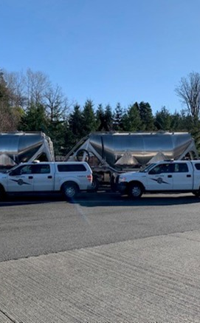
Definitions continued
Commercial motor vehicle means any self-propelled or towed motor vehicle used on a highway in interstate commerce to transport passengers or property when the vehicle—
Has a gross vehicle weight rating or gross combination weight rating, or gross vehicle weight or gross combination weight, of 10,001 pounds (4,536 kg) or more, whichever is greater; or
Is designed or used to transport more than 8 passengers (including the driver) for compensation; or
Is designed or used to transport more than 15 passengers, including the driver, and is not used to transport passengers for compensation; or
Is used in transporting material found by the Secretary of Transportation to be hazardous under 49 U.S.C. 5103 and transported in a quantity requiring placarding under regulations prescribed by the Secretary under 49 CFR, subtitle B, chapter I, subchapter C.
Authority - 49 UCR 14504a and/or local jurisdictional authority.
Notes:
Now let’s talk about what qualifies as a commercial motor vehicle, or CMV, under the UCR program.
A CMV is defined as any self-propelled or towed vehicle used on a highway in interstate commerce to transport passengers or property, when it meets any of the following conditions:
It has a gross vehicle weight rating or gross combination weight rating of 10,001 pounds or more,
It is designed or used to transport more than 8 passengers for compensation,
It is designed or used to transport more than 15 passengers, including the driver, not for compensation,
Or it is used to transport hazardous materials in quantities that require placarding.
If a vehicle meets any of these criteria and is involved in interstate commerce, it falls under the scope of UCR enforcement.
The legal authority for this definition and for the entire UCR program is established in Title 49 of the United States Code, Section 14504a. This is the statute that provides states the power to enforce UCR and collect fees from applicable entities.

Slide 7
Value
Why the Unified Carrier
Registration Plan is Important
Notes:
Let’s talk about why UCR matters. At a high level, UCR is more than a registration requirement. It’s a critical funding mechanism that support its highway safety and enforcement operations across the country.
Without UCR, states would lack the resources needed to carry out inspections, invest in safety programs, and keep noncompliant carriers off the road.

Slide 8
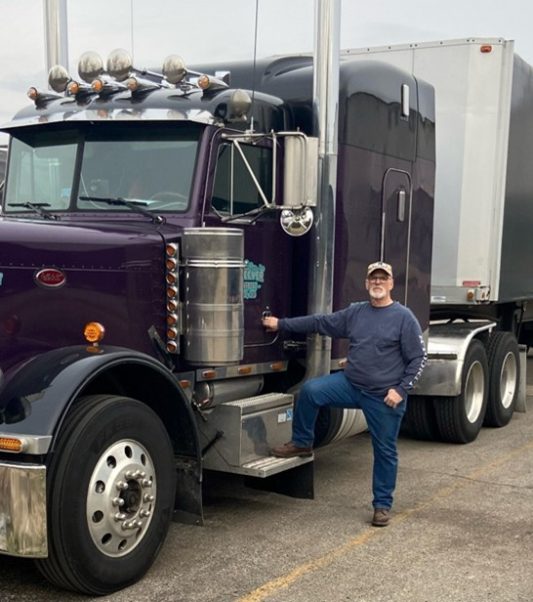
Value of UCR
The use of fees by the states. Focus/connection to highway safety: equipment, technology, manpower.
Benefit to industry
Goal: 85% registration rate, educate roadside enforcement, issue violations, citations, or civil fines
Consequences for non-enforcement: audit finding, possibly no fee reduction, potential loss for revenue from citations or civil fines, encourages illegitimate carrier operations
Notes:
States use the revenue collected through UCR for things like inspection equipment, training programs, enforcement staffing, and safety technology. This funding plays a direct role in improving highway safety and ensuring consistent enforcement from state to state.
UCR also benefits the industry by encouraging fairness. Carriers that operate legally and pay their registration fees don’t have to compete with unregistered operators who are cutting corners.
One of the program’s national goals is to reach and maintain an 85% registration rate across the board. When enforcement is strong, we’re more likely to hit that target. When it’s weak, there are real consequences - not just in safety, but also in potential audit findings, lost revenue, and an increase in illegitimate operations.

Slide 9
Value of UCR
Consequence –
Without it encourages non-compliance
Those offenders
without UCR have
other safety violations
CDL
HOS
Drug & Alcohol Violation
Equipment,
brakes, etc.
Notes:
Besides checking for UCR credentials, inspectors are also looking for signs of possible impairment, human trafficking, and other violations that may not be listed directly on a commercial vehicle inspection form.
Carriers who fail to register for UCR often have deeper compliance issues. These can include expired CDLs, hours-of-service violations, drug and alcohol infractions, or serious equipment failures.
Data shows that carriers cited for UCR violations are significantly more likely to be placed out of service for other safety reasons. Enforcing UCR isn’t just about ensuring registration, it’s a critical tool for identifying high-risk operators and keeping unsafe carriers off the road.
This enforcement helps protect the public, support legitimate businesses, and maintain the integrity of our transportation system.
In addition, Enforcement helps decrease fees for the industry.

Slide 10
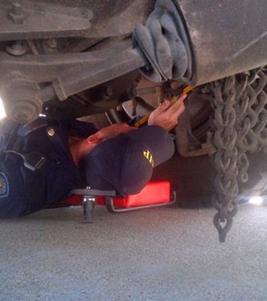
Safety Violations
Notes:
To recap: carriers that fail to comply with UCR often have other serious safety issues. These can include violations related to licensing, equipment, or substance use.
UCR enforcement helps us flag these high-risk operators early before those risks turn into incidents on the road.

Slide 11
Applicability
Who is subject to UCR
Who is not subject to UCR
Specific Business Types Interpretations
Notes:
Next, we’ll look at who is subject to UCR and who is not. This is a foundational part of enforcement. If a business operates commercial vehicles in interstate commerce, or arranges the movement of goods or passengers across state lines, it is likely subject to UCR even if the vehicle itself doesn’t leave the state.
We’ll also explore specific interpretations for certain types of operations, so you can feel confident in making accurate determinations in the field.

Slide 12
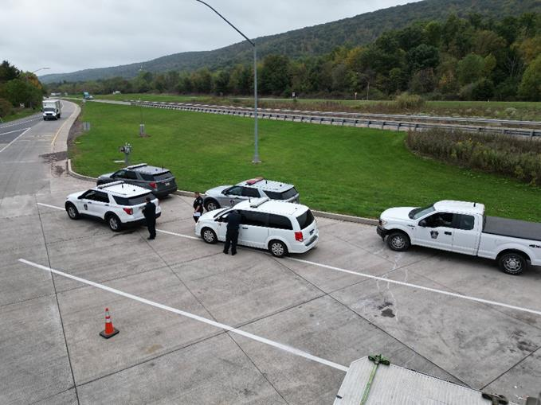
Who is subject to UCR
Who is Subject to UCR: All motor carriers (for-hire, private, and exempt), brokers, freight forwarders and leasing companies operating in interstate and international commerce are subject to the UCR Agreement.
What is Interstate Commerce: Carriers based in Canada and Mexico that operate in the U.S. are also subject to the UCR Agreement. Whether a vehicle is involved in interstate or international commerce depends on the movement of its cargo across state or national lines. If the goods/passengers being transported cross state or international lines at any point in their journey, it is considered interstate commerce (even if the vehicle itself doesn’t leave the state).
Operations In Nonparticipating States: A business is not exempt from the requirements of the UCR program merely because its operations are restricted to states that do not participate in UCR.
Notes:
UCR applies broadly to entities involved in interstate or international commerce. This includes:
For-hire carriers,
Private carriers,
Exempt carriers,
Brokers,
Freight forwarders, and
Leasing companies that operate vehicles in commerce.
It’s important to remember that UCR applicability doesn’t depend solely on the physical movement of a vehicle. If the cargo, goods or passengers, is part of an interstate or international movement at any point in its journey, that’s considered interstate commerce, and UCR applies.
This includes U.S.-based carriers as well as those based in Canada or Mexico operating within the United States.
Also, operating in nonparticipating states does not exempt a business. UCR is still required even if the carrier only travels through or is based in states that don’t enforce the program directly.

Slide 13

Who is not subject to UCR
Who is Not subject to UCR: A motor carrier who operates solely intrastate (those that do not handle interstate/international freight or make interstate/international movements).
Private motor carriers of passengers (those that operate as a private motor carrier engaged in the interstate/international transportation of passengers which is provided in the furtherance of a commercial enterprise and is not available to the public at large).
Notes:
Let’s look at who is not subject to UCR.
Intrastate-only carriers are the most common exemption. These are companies that transport goods or passengers solely within one state, with no connection to interstate commerce.
Private motor carriers of passengers, such as those transporting employees for business purposes but not offering transportation to the public, are also generally excluded.
But remember: many businesses believe they’re intrastate when, in fact, their shipments or operations are part of a larger interstate movement. Enforcement officers must evaluate the full context of the shipment, not just the day’s route.

Slide 14
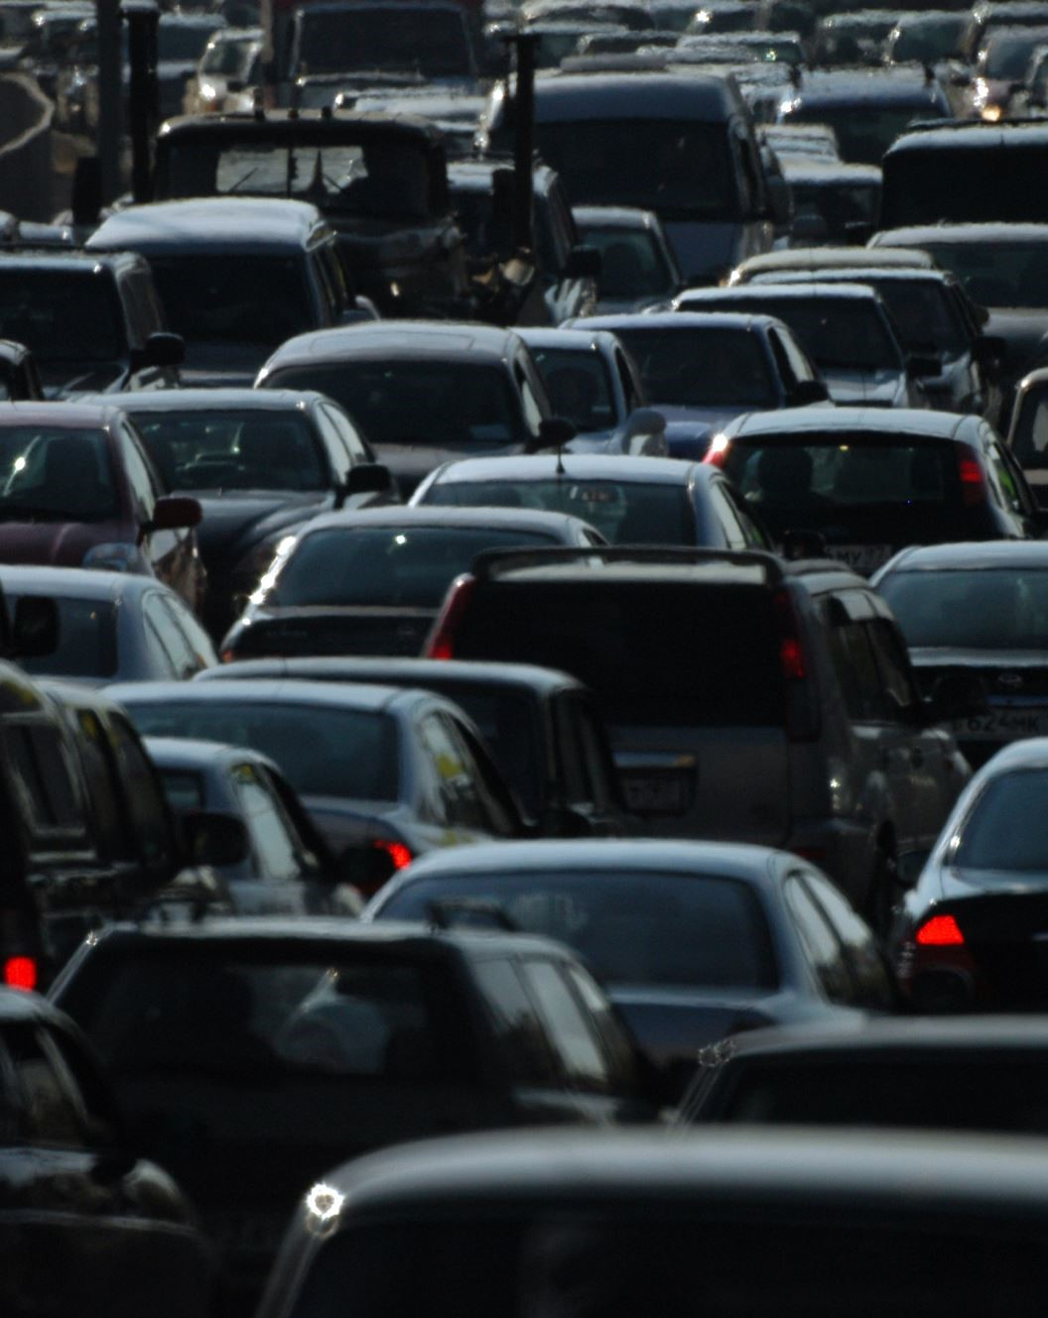
Specific Business Types Included or Excluded from UCR
Leased Vehicles
New Operations
Non-Commercial Motor Vehicles
Notes:
The UCR Board of Directors has determined the status for UCR of a number of specific kinds of transportation operations. Generally, though not in all instances, the question has been whether a given operation is or is not required by the Act to register for UCR and pay UCR fees. By no means are all kinds of transportation businesses represented in the following slides, but they may help to clarify how the general rules of the UCR program apply in specific instances. To an extent, these are practical applications of the more general rules of the UCR program.
Leased Vehicles: If a vehicle is operated by a motor carrier with an interstate DOT number (and this includes a motor carrier that should have obtained a DOT number as an interstate carrier but has not done so), the vehicle is to be counted in the fleet associated with that DOT number, unless it is operated by that fleet only under a short-term lease or leases. If the only vehicles a motor carrier operates are operated by it under short-term lease, it should pay UCR fees at the lowest bracket, since, under UCR, those vehicles are not counted as “operated.”
New Operations: A motor carrier that began operation only recently are subject to the UCR requirements. The carrier must compute its UCR fee according to the latest Form MCSA-1 it has filed with FMCSA.
Non-Commercial Motor Vehicles: Some for-hire motor carriers may operate only vehicles that are not classified as CMV, typically because the vehicles do not meet the gross weight or combination weight or gross vehicle weight rating or combined gross vehicle weight rating or carry fewer passengers than vehicles included in the definition of the term commercial motor vehicle. The FMCSA requires many of these motor carriers to have federal operating authority or “MC” numbers in order to operate. Such a business must register for UCR because it is one of the types of businesses covered by the program, but it would ordinarily pay a UCR fee in the lowest bracket because it operates no commercial motor vehicles.

Slide 15

Specific Business Types Included or Excluded from UCR
Leasing Companies
Drive-Away & Tow-Away Operations
Notes:
Leasing companies as defined for the purposes of UCR – that is, entities in the business of leasing or renting commercial motor vehicles without drivers to interstate motor carriers are not required to register with USDOT and obtain a DOT number, if they do not operate any vehicles. FMCSA considers a leasing company that moves any of its vehicles from place to place over the highway – for its own reasons or for the convenience of a customer, for example – to be a private motor carrier of property, which is required to register and obtain a DOT number. However, for purposes of the UCR program, a business that otherwise falls into the leasing company category does not become a carrier merely because it repositions its own vehicles, even across state lines. A business that is solely a leasing company, and not a carrier, pays a UCR fee at the lowest level.
UCR is applicable to drive-away and tow-away operations in interstate commerce since they represent motor carrier operations. The vehicles being hauled/driven are considered to be their freight rather than vehicles that they operate. Therefore, these types of operations will pay the lowest fee category (unless they engage in carrier operations other than drive-away and tow-away).
Next are Specific Business Types Included or Excluded from UCR.

Slide 16

Specific Business Types Included or Excluded from UCR
Hazardous Materials
Commercial Zones
Carriers Exempt From Operating Authority
Agricultural Haulers & Farm Vehicle
Short-Term & Seasonal Operations
Notes:
Some situations are less obvious, but still subject to UCR.
A carrier hauling placarded amounts of hazardous materials in interstate commerce must register for UCR, regardless of the weight of the vehicles it uses in that application. The definition of a commercial motor vehicle in federal law that applies to the UCR program includes all vehicles, regardless of weight, used to haul placardable amounts of HM. Purely intrastate carriers that haul placarded amounts of HM are also required by federal law to register with DOT and obtain a DOT number. However, because these carriers are not interstate, they are not subject to UCR requirements.
Motor carriers transporting freight or passengers only within a commercial zone are required to register for UCR. There is no exemption in the Act for operations wholly within a commercial zone, as long as interstate freight or passengers are hauled.
Carriers that haul agricultural or other commodities exempt from federal operating authority requirements are required to register for UCR. The Act specifically includes carriers exempt from operating authority within the purview of the UCR program.
Agricultural haulers operating in interstate commerce, including those operating under special plates, are subject to UCR, even though they may be exempt from other registration or specific safety requirements. It should be noted that movements of agricultural produce by commercial motor vehicle to a railhead or ocean or river port are almost always interstate in nature.
A short-term and seasonal transportation operation, provided it operates in interstate commerce, will still be required to register for UCR, even though it may be idle for much of the year.

Slide 17

Specific Business Types Included or Excluded from UCR
Government Vehicles & Contractors
School Buses
Trash & Recyclables
Charities & Nonprofits
Emergency Vehicles
Household Goods Agent:
Notes:
This slide wraps up several remaining exceptions and edge cases:
Government-owned vehicles at the federal, state, tribal, or local level are exempt from UCR.
However, if a private business is contracted to do government work, like a mail carrier or municipal trash hauler, they must register for UCR.
School bus operators involved in interstate travel must register, though they can exclude intrastate-only vehicles from their fleet count.
Charities and nonprofits are not exempt if their operations qualify as interstate commerce.
Emergency vehicles used solely for disaster response, particularly by utilities, may be exempt under federal emergency provisions.
And finally, household goods agents working under a van line’s authority are typically covered under that van line’s UCR registration.
Government Vehicles & Contractors. All levels of government are exempt from the requirements of the Act. Towns, cities, counties, states, tribal governments, and the federal government do not need to register for UCR because of any transportation operations they may conduct themselves. However, businesses under contract with a government entity to conduct transportation operations are required to register for UCR. A carrier under contract with the U.S. Postal Service to carry mail, for example, is an operation of this sort, and must register.
A school bus operator that contracts to transport school children to and from school and school-sanctioned functions is required to register for UCR, if the operations require the buses to cross a state or national border, since it is therefore operating in interstate commerce. However, a carrier primarily engaged in intrastate school bus operations may exempt its intrastate school buses from its fleet count.
Beginning in 2009 interstate carriers are no longer excluded from UCR merely because they haul nothing but trash and recyclables. Trash and recyclables are not considered “property” under federal transportation law, and the wording of the Act as it was originally passed by Congress excluded interstate haulers of trash and recyclables from the requirements under UCR. However, the Act was subsequently amended to include those operations.
Charities & Nonprofit operations are not exempt from registering for UCR if their transportation operations are in interstate commerce.
Emergency Vehicles: An electric utility or other business that is registered with FMCSA as an “Intrastate Non-Hazmat Carrier” or an “Intrastate Hazmat Carrier” that operates vehicles interstate for the sole purpose of responding to a request for assistance as a result of a declared emergency pursuant to 49 CFR Part 390.23, shall be exempt from the requirements of UCR.
An agent of a household goods van line is not subject to UCR unless it has interstate operating authority of its own. The van line, however

Slide 18
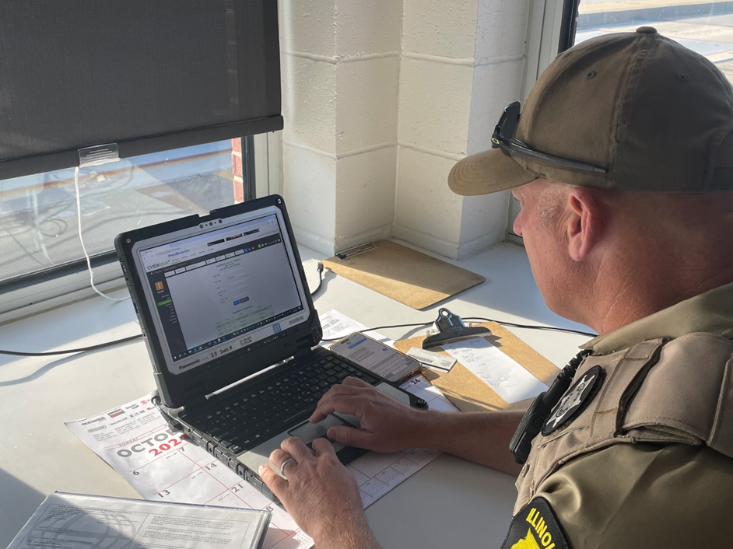
How to Verify
CVIEW
SAFER
UCR Website
UCR Enforcement, & Inspection Software
FMCSA's SafeSpect
Notes:
There are several tools available to help verify whether a carrier is registered with UCR. These include:
CVIEW (Commercial Vehicle Information Exchange Window)
SAFER System
The UCR Enforcement Portal at www.ucr.gov/enforcement
UCR Enforcement, and Inspection Software (like ITERIS and INSPECT for example)
FMCSA's SafeSpect
These tools allow you to quickly look up a carrier’s UCR status using their USDOT number or company name, helping you make real-time decisions during roadside inspections.

Slide 19
How to Verify Using Databases/Software
Notes:
When conducting a stop, always check the carrier’s registration status through one of these databases. Most are integrated into inspection systems or available via mobile tools.
If UCR is not current, and the carrier is otherwise subject to the program, that’s grounds for a violation under federal or state law.
Again, the key takeaway is that Inspectors have reliable, real-time tools to determine whether a carrier is compliant. Use them as part of your standard process, especially when UCR status seems unclear or questionable.

Slide 20
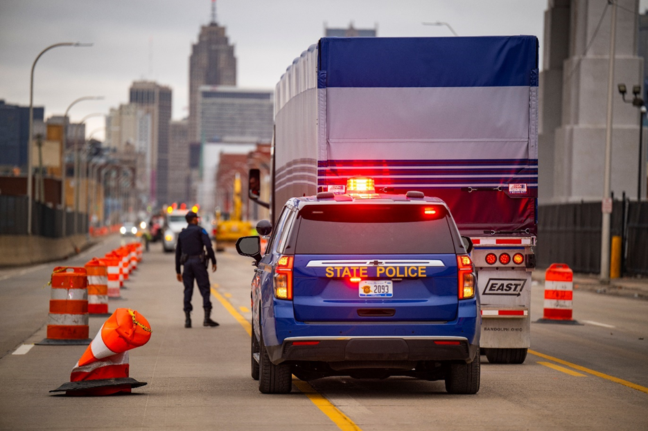
How is UCR Enforced?
Section code 392.2UCR is reserved for capturing UCR violations on roadside inspections.
Many states have a statute or regulation requiring motor carriers and other businesses subject to UCR that law enforcement can cite when violations are discovered.
392.2UCR violations cited on roadside inspections are analyzed and presented back to the states through the Enforcement Efficiency Report (EER). The EER can identify total violations recorded and violations missed, explained in a separate report known as the Should Have Been (SHB) report.
Notes:
UCR violations are tracked using Section Code 392.2UCR during roadside inspections.
Most states also have a corresponding statute or regulation requiring compliance with UCR. If a violation is found, it can be cited under either federal or state authority.
These roadside violations are recorded and reported through the Enforcement Efficiency Report, which tracks both actual citations and missed opportunities known as 'Should Have Been' violations, or SHBs.
States can use these reports to evaluate how effectively they’re enforcing UCR and to identify where improvements are needed.
Remember, consistent enforcement doesn’t just protect the integrity of the program, it also ensures your state receives its fair share of UCR funds based on accurate, documented enforcement activity.

Slide 21
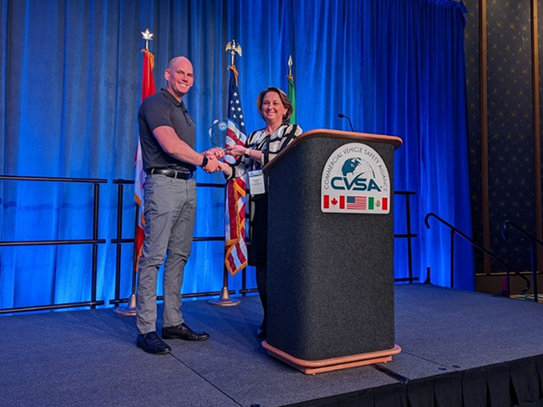
UCR Statistics
Quarterly or monthly recognition in UCR Dispatch Newsletter for inspector who issues the most UCR violations
Annual Award to States
Statistics – only 1 in 3 UCR violations are issued in roadside inspections. Data shows that carriers cited for UCR are 2.5 times more likely to be placed out of service.
Notes:
Let’s take a look at some of the national statistics tied to UCR enforcement.
Currently, only about 1 in 5 UCR violations are actually being cited during roadside inspections. That means there’s a significant gap between carriers operating without registration and actual enforcement action.
To encourage stronger enforcement, UCR recognizes top-performing inspectors and states. Monthly or quarterly shoutouts are featured in the UCR Dispatch Newsletter, and there’s even an annual award for states that lead in enforcement activity.
But here’s the most important stat: carriers that are cited for UCR violations are 2.5 times more likely to be placed out of service for other reasons whether it's due to equipment issues, licensing violations, or safety concerns.
This makes UCR enforcement a powerful tool not just for compliance, but for identifying high-risk carriers before they cause harm. Strong, consistent enforcement helps improve highway safety, supports fair competition, and positions your state for recognition and funding opportunities.

Slide 22
Scenarios
Review the following
seven scenarios
Notes:
In this next section, we’ll walk through a series of real-world scenarios. Each one is designed to test your understanding of UCR applicability and help you build confidence in making enforcement decisions.
As we go through them, think about the carrier’s status, the type of operation, and whether or not UCR registration is required. Let’s start with Scenario 1.

Slide 23
Scenario
01
Should you issue a violation to the following types of motor carriers
if they haven’t registered for UCR?
Notes:
Scenario 1: A motor carrier that operates in interstate commerce has not registered for UCR.
This is a straightforward case. If the carrier meets the criteria for UCR operating in interstate or international commerce and falling under one of the covered business types, they are required to register. If they haven’t, a violation should be issued.

Slide 24
Scenario
02
An interstate-designated motor carrier on an intrastate trip?
Notes:
Scenario 2: An interstate-designated motor carrier is conducting what appears to be an intrastate trip.
Remember: UCR registration is based on the overall operation, not just the specific trip. If the carrier is designated as interstate by FMCSA, they are expected to maintain UCR compliance, even if the vehicle is only making in-state deliveries that day. Again, the key point is that the interstate designation on a carrier’s USDOT record signals the need for UCR registration regardless of the route taken on any single day
In this case, a violation should be issued if the carrier lacks valid UCR registration.

Slide 25
Scenario
03
An intrastate-designated motor carrier on an interstate trip?
Notes:
Scenario 3: An intrastate-designated motor carrier is found on an interstate trip.
Here, the movement of the cargo matters. If the goods originated in another state or will be delivered across state lines, even if the carrier only handles one leg of that movement, they are now operating in interstate commerce.
This trip makes the operation subject to UCR, and if the carrier is not registered, a violation can be issued.

Slide 26
Scenario
04
An intrastate-designated motor carrier with an active interstate MC number
on an intrastate trip?
Notes:
Scenario 4: An intrastate-designated motor carrier has an active MC number and is on an intrastate trip.
Having an MC number indicates they’ve sought authority for interstate operations. Even if this particular trip is within state lines, the carrier may be considered interstate under FMCSA definitions.
If the company has an MC number and operates vehicles that meet the commercial criteria, they should be registered under UCR.

Slide 27
Scenario
05
An inactive motor carrier on an interstate trip?
Notes:
Scenario 5: An inactive motor carrier is operating a vehicle on an interstate trip.
This is a red flag. An inactive carrier should not be operating at all, let alone in interstate commerce.
If you encounter this situation, cite for UCR and flag for additional follow-up potentially including FMCSA notification depending on the broader compliance picture.

Slide 28
Scenario
06
A motor carrier with no USDOT number on an interstate trip?
Notes:
Scenario 6: A carrier with no USDOT number is operating in interstate commerce.
This is a serious violation. Any carrier involved in interstate operations must have a valid USDOT number and, if required, must also be registered with UCR.
Operating without a USDOT number indicates a potentially unauthorized and unregulated carrier, a major compliance and safety concern. This situation warrants a UCR violation and likely further enforcement action.

Slide 29
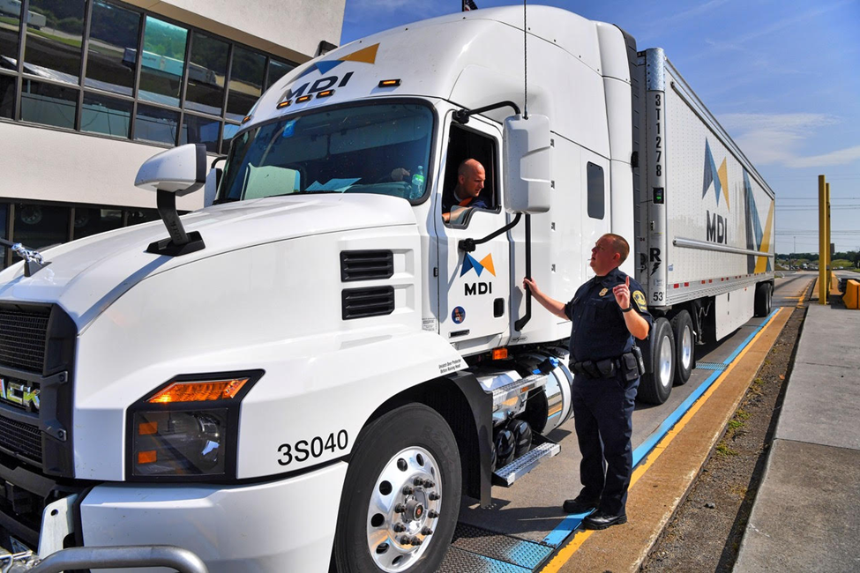
Help Tools
Comprehensive help tools/resources
UCR Website
CVSA LMS
Inspection Bulletin
UCR Education & Training Center
Agency Resources
Internal
External
SMES
FMCSA Site
Notes:
UCR enforcement isn’t something you have to navigate alone. There are a wide range of tools and resources available to support your work whether you’re in the field or training new staff.
These include the official UCR website, the CVSA Learning Management System, inspection bulletins, and the UCR Education and Training Center. These platforms provide updated guidance, enforcement policies, and clarifications on grey areas.

Slide 30
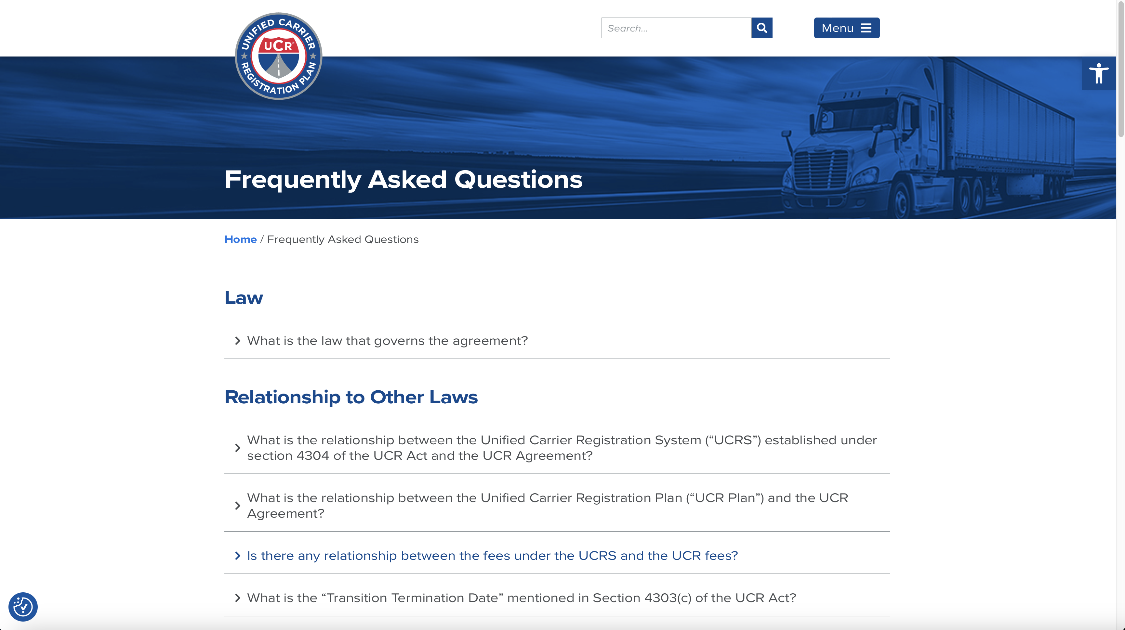
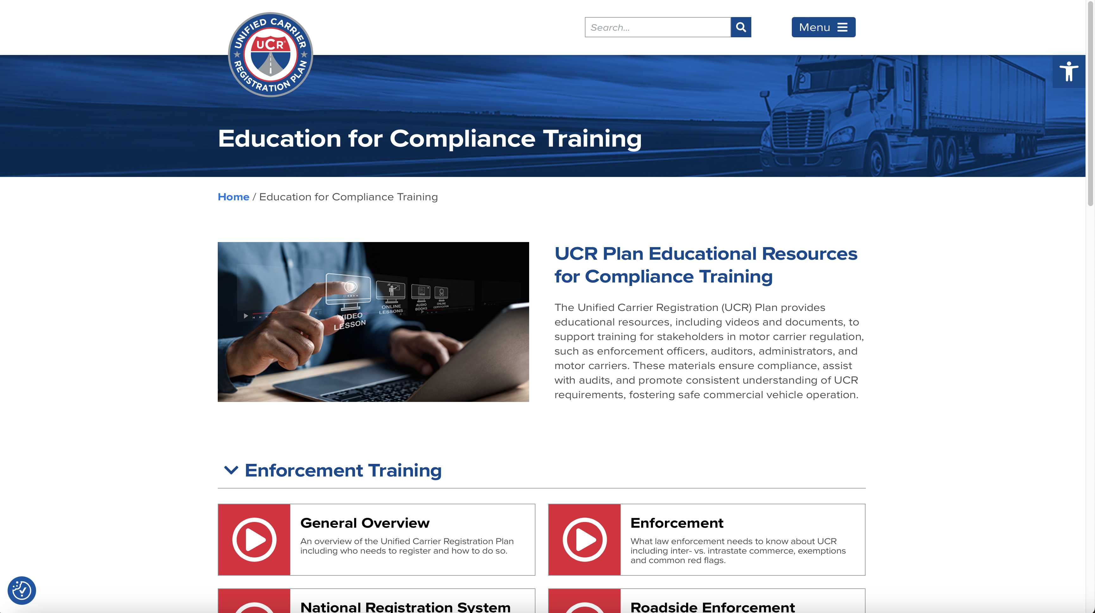
Help Tools
Notes:
This slide highlights two of the most useful resources for day-to-day enforcement: the UCR FAQs and the UCR Education & Training Center.
The FAQ section on the UCR website is a great starting point when you need quick answers on applicability, exceptions, or unusual situations. It’s regularly updated and written with enforcement in mind.
The Education & Training Center offers more in-depth materials, like refresher modules that can help both new and experienced inspectors stay sharp on UCR rules.
These tools are especially helpful when you're in the field and need reliable, accurate information fast.

Slide 31
Summary & Reminders
Companies that move, or arrange for movement of property or passengers in interstate or international commerce are subject to UCR
UCR can be confirmed online www.ucr.gov/enforcement
Get involved by joining the Enforcement Subcommittee by emailing jkines@board.ucr.gov
For additional information visit plan.ucr.gov
Notes:
As a reminder, UCR applies to companies that move or arrange the movement of goods or passengers in interstate or international commerce.
Whether it’s a for-hire carrier, broker, or leasing company, if they’re engaged in qualifying activity and operate in or across state lines, they likely fall under the UCR Agreement. Enforcement starts with knowing who these entities are and verifying their compliance.

Slide 32
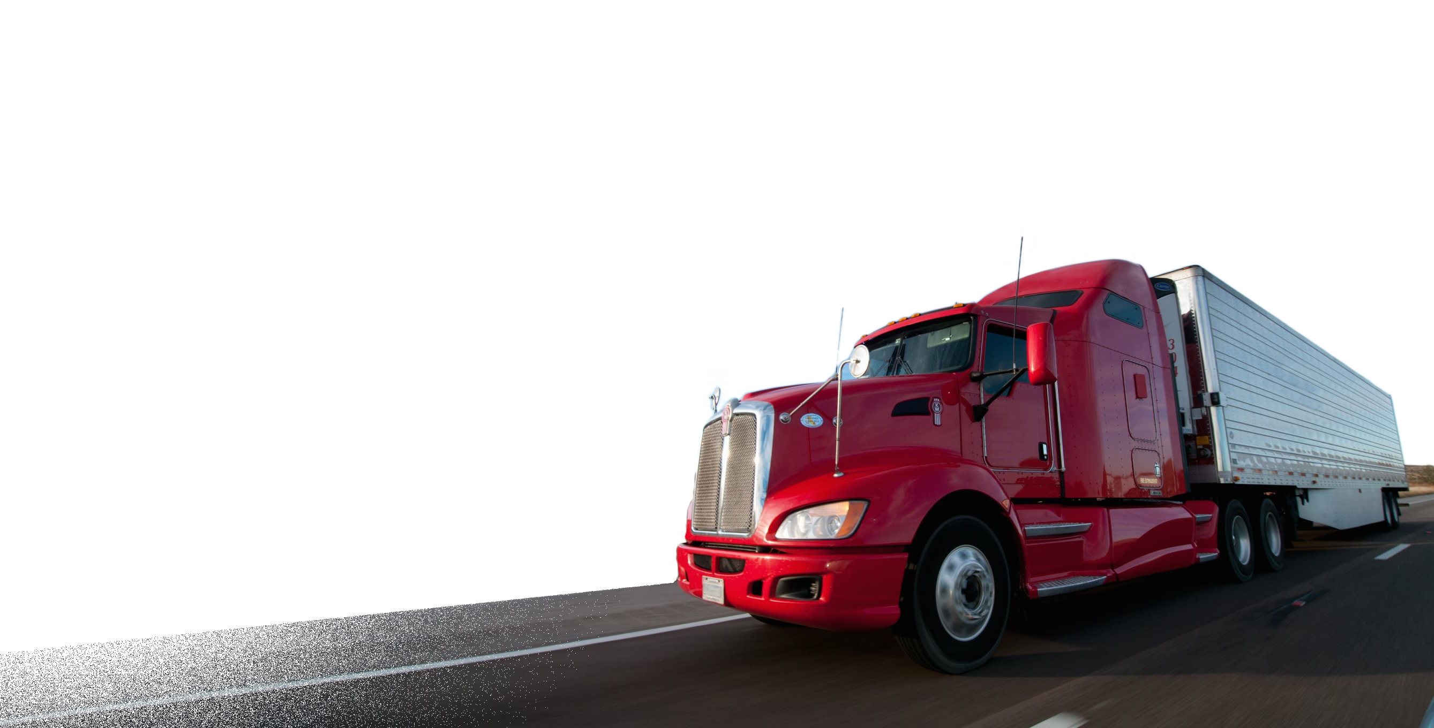
Summary & Reminders
Companies that move or arrange for movement of property or passengers in interstate or international commerce are subject to UCR.
Notes:
Companies that move or arrange for movement, property, or passengers in interstate or international commerce are subject to the UCR fee.

Slide 33
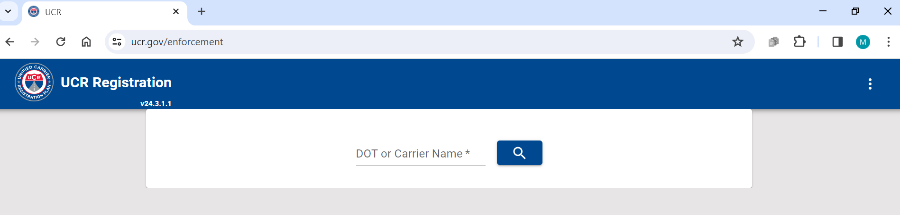
Summary & Reminders
UCR can be confirmed online www.ucr.gov/enforcement
Notes:
UCR compliance can be confirmed quickly and easily using the online enforcement portal at www.ucr.gov/enforcement.
This site allows you to search by USDOT number or carrier name, view registration status, and pull up other relevant carrier information. It’s a tool every inspector should have bookmarked.

Slide 34
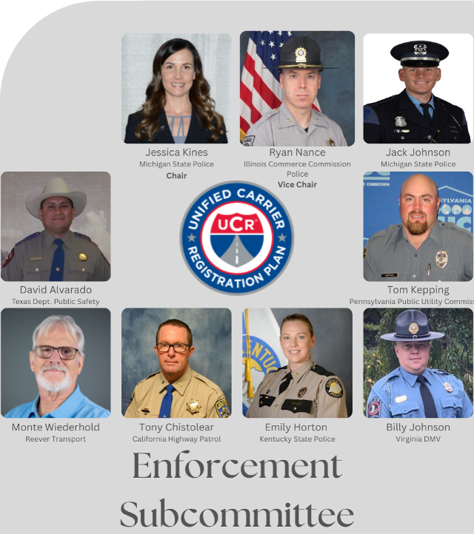

Summary & Reminders
Join our team!
Get involved by joining the Enforcement Subcommittee by emailing jkines@board.ucr.gov
Notes:
If you're interested in contributing to the future of the program, consider joining the UCR Enforcement Subcommittee.
This group brings together enforcement professionals from across the country to share challenges, improve training, and help shape the direction of UCR policy.
You can get involved by emailing: jkines@board.ucr.gov.

Slide 35
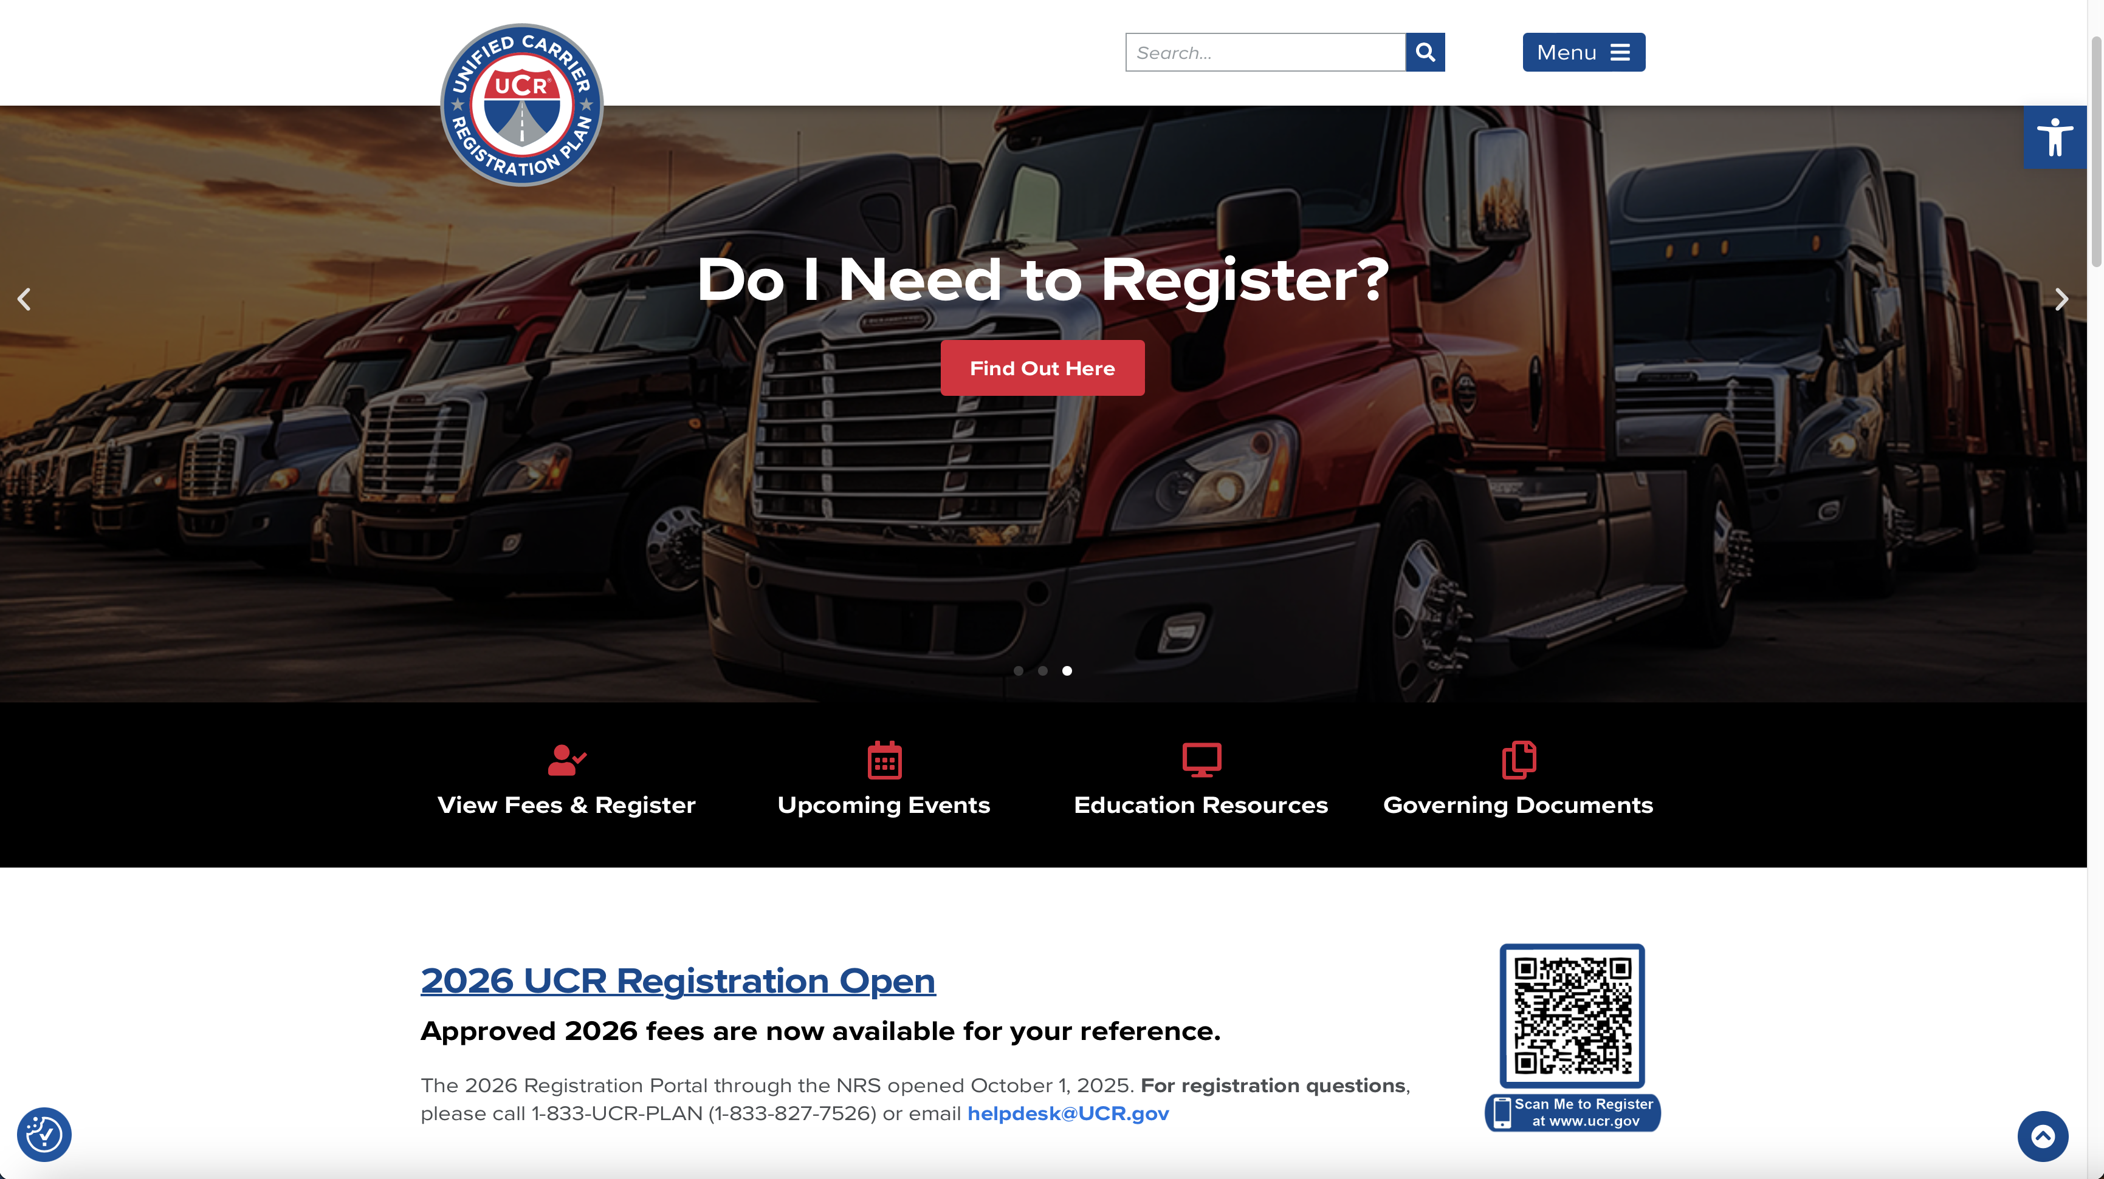
Summary & Reminders
For additional information
visit www.plan.ucr.gov
Notes:
For even more information, visit the full UCR site at www.plan.ucr.gov.
Here you’ll find documentation, legislative background, training content, and enforcement tools that can support you long after this session ends.

Slide 36
Thank you!
Notes:
Again, thank you.
It was a pleasure speaking with you and providing this high-level overview of the enforcement process, key responsibilities, and the tools and resources available to support our efforts.

